Slide 1

A Gentle introduction to LLMs and LLaMa
Ivan Gentile
IFAB
EuroCC Italy

Slide 2

Gen AI
Generative AI
With Gen AI we refer to applications of AI where new data is created (generated) upon user interaction
ChatGPT/LLaMa generate language
DALL-E / Midjourney generate images
SORA / Pika generate video
SUNO / udio generate sound/music
Autoregressive Models
Diffusion Models

Slide 3
Gen AI
Generative AI
With Gen AI we refer to applications of AI where new data is created (generated) upon user interaction
ChatGPT/LLaMa generate language
DALL-E / Midjourney generate images
SORA / Pika generate video
SUNO / udio generate sound/music
Autoregressive Models
Diffusion Models

Slide 4

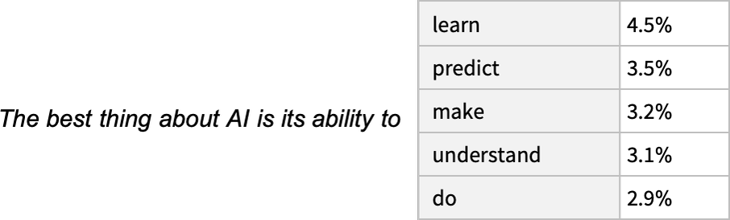
Autoregressive Language Models
Autoregressive models generate data sequentially, one step at a time.
In the case of text generation, autoregressive models predict the next token (word or subword) based on the previously generated tokens.
The generation process is iterative, with each step depending on the output of the previous steps.
Notes:
Mentione the box is a vocabulary distribution
What kind of distribution do predicted tokens follow??

Slide 5
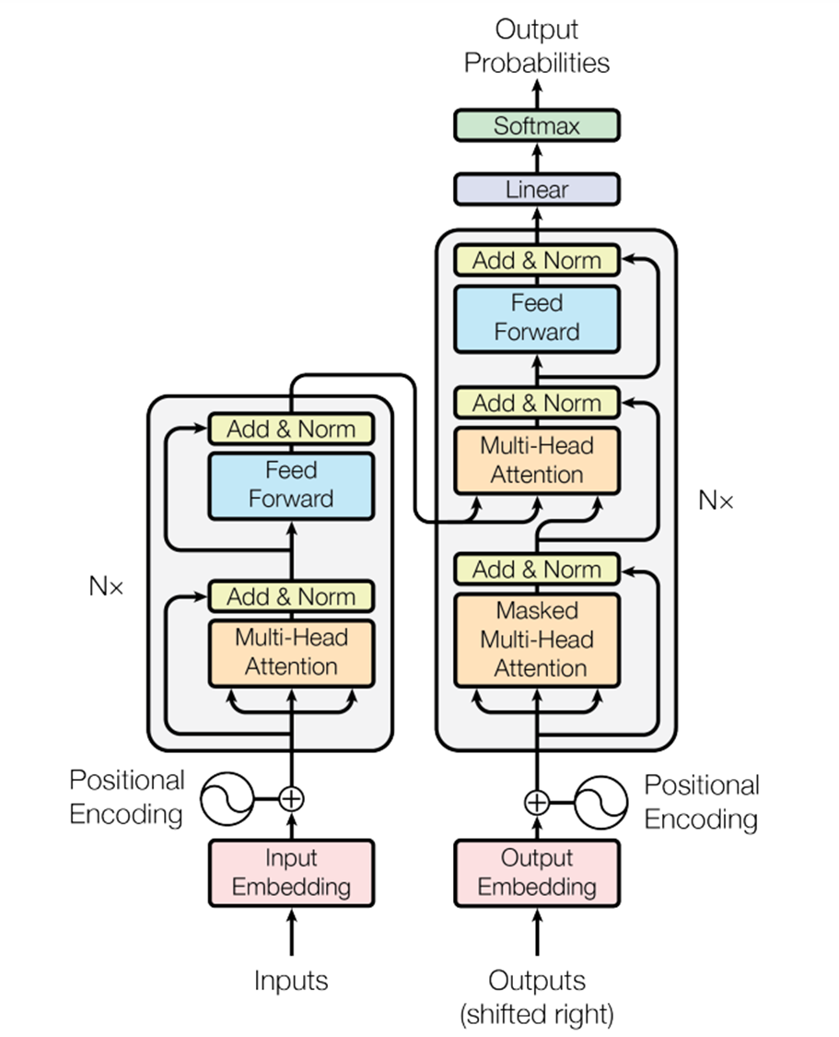
Generation Flow
1
Input Processing
Tokenization: Breaking down input text into tokens
Embedding: Converting tokens into dense semantic vectors
Positional Encoding: Adding position information to the embeddings
2
Transformer Decoder Architecture
Multi-Head Self-Attention: Attending to different parts of the input
Feed Forward Neural Network: Processing the attended information
Residual Connections and Layer Norm: Enabling stable training
3
Output Generation
Vocabulary Distribution: net output is a distribution over the vocabulary
Sampling Techniques: Methods like top-k sampling for toke selections
Iterative process: Selected token is fed back to generate the next one
Notes:
I need to review Positional encoding
Residual connection
And specially sampling techniques

Slide 6
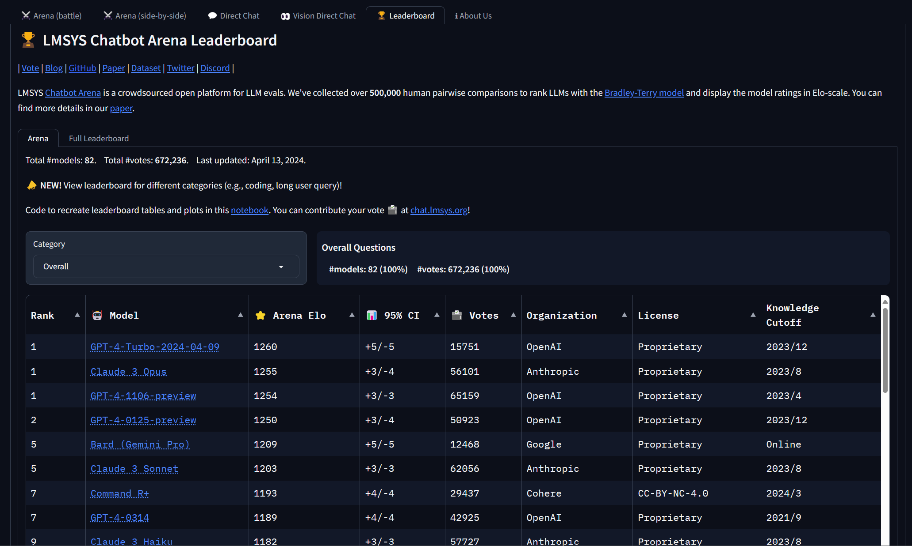
State of the Art Models
Notes:
ntroduce the concept of model evaluation and benchmarking. Explain how models like LLaMa are assessed based on their performance on specific tasks or metrics.
Discuss the importance of comparing and contrasting different models to understand their strengths, weaknesses, and suitability for various applications.

Slide 7
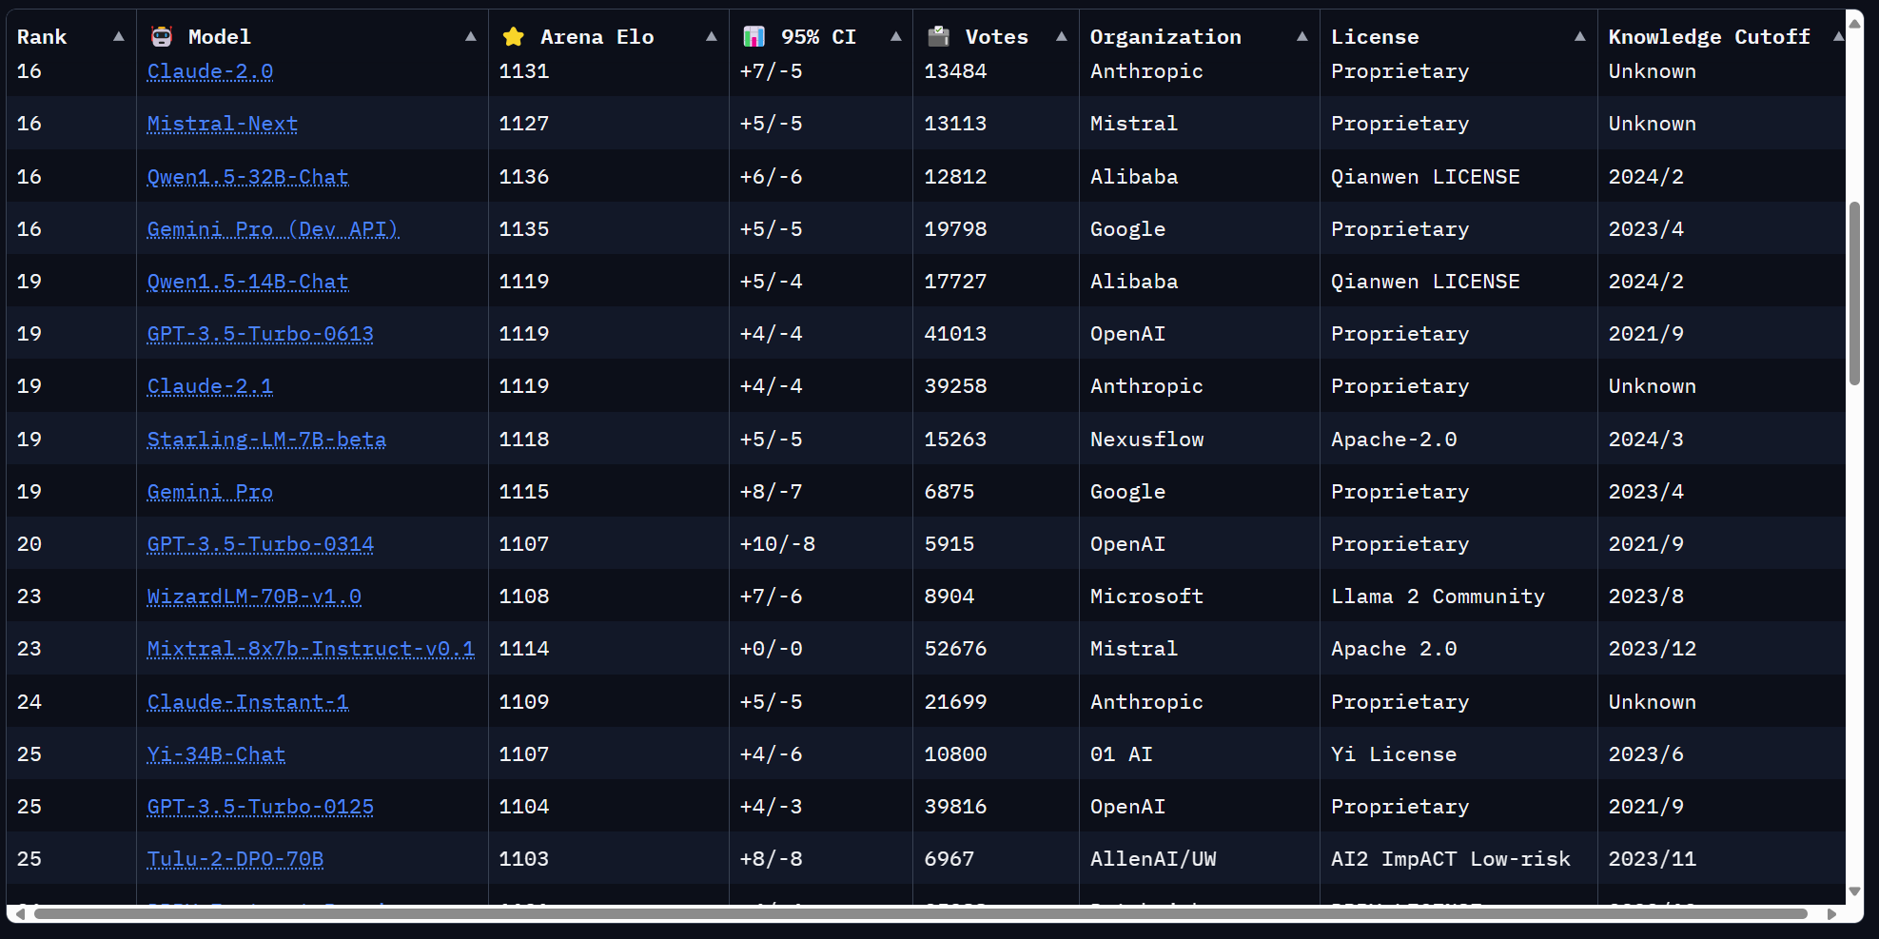
State of the Art Open Models

Slide 8

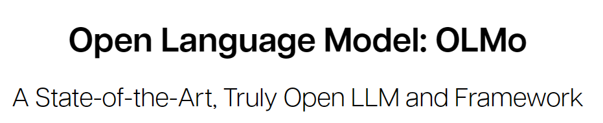
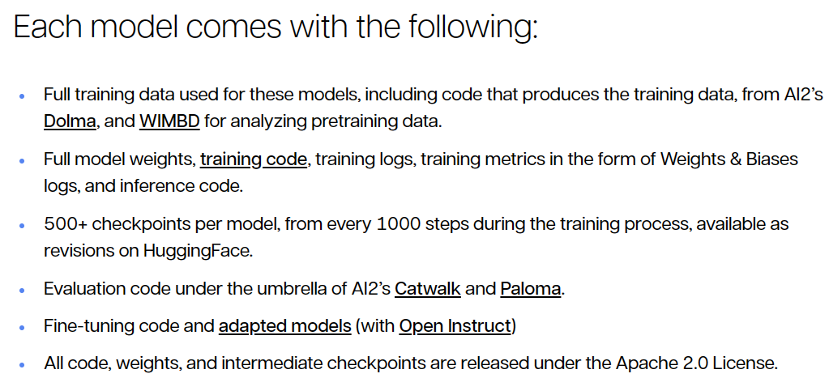
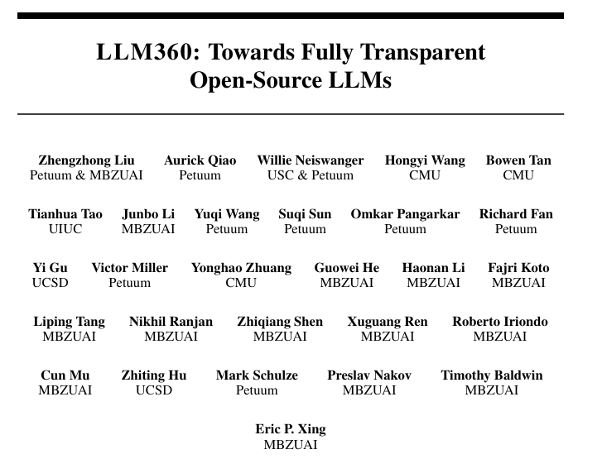
Open Source vs Open Weights
Notes:
I need to read more into the open source llms

Slide 9
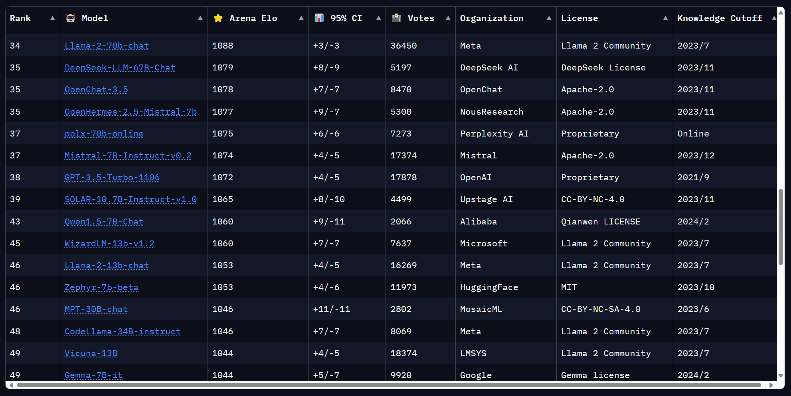
Meta LLaMa2

Slide 10
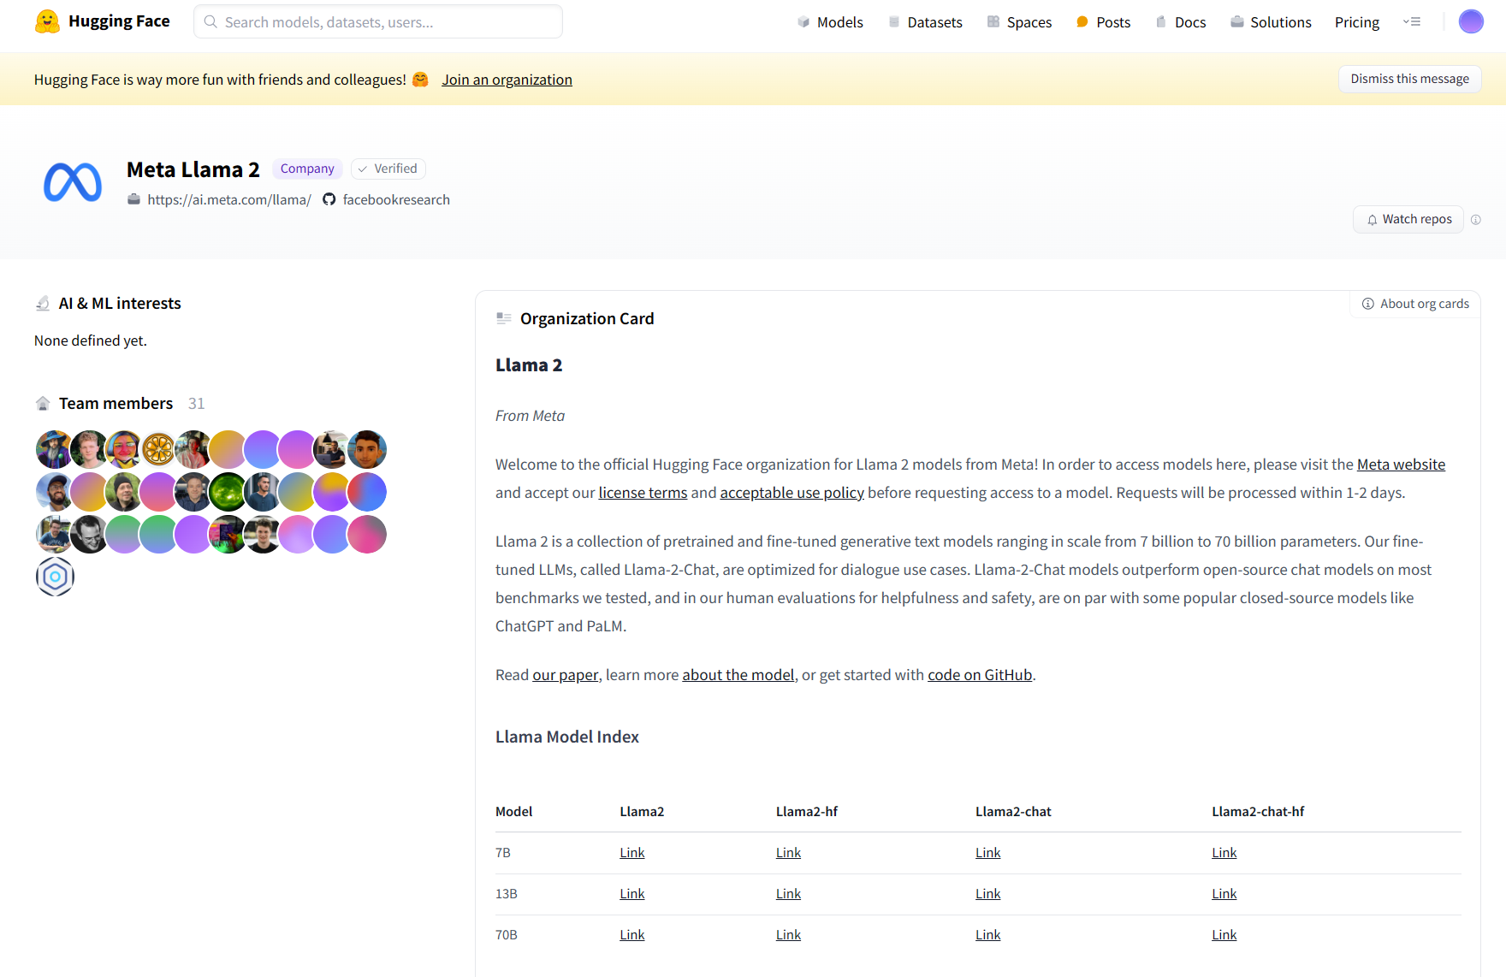
Different model sizes for different computing capabilities
Notes:
Size of Models --> 7b, 70B

Slide 11
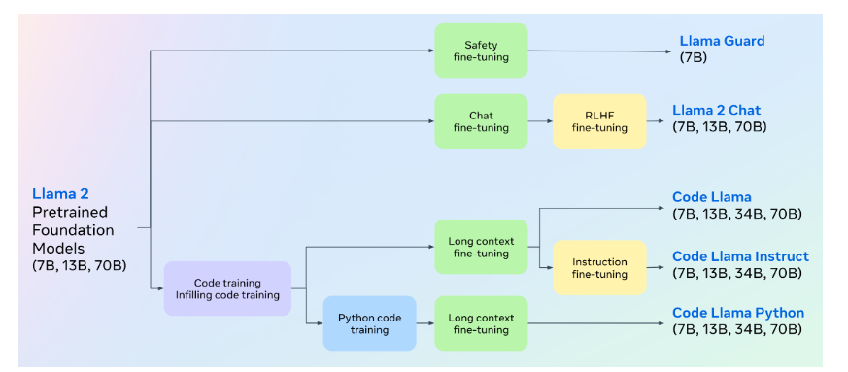
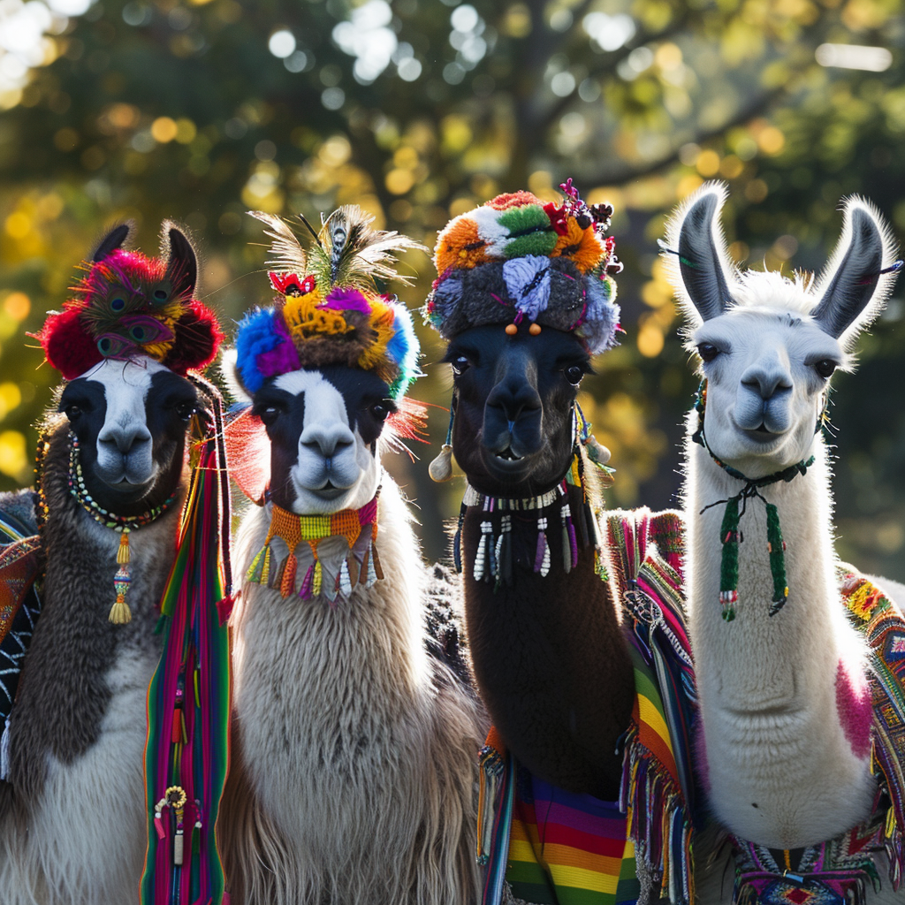
Different flavors for different use cases
Llama 2 = Foundational model (good at text completion)
Llama2 – chat = Good at question answering (like ChatGPT!)
CodeLlama - Instruct: for instruction following and safer deployment
LlamaGuard: input-output safeguard model.
* – hf = Hugging Face format
Notes:
Investigate the case of llama2 –hf

Slide 12
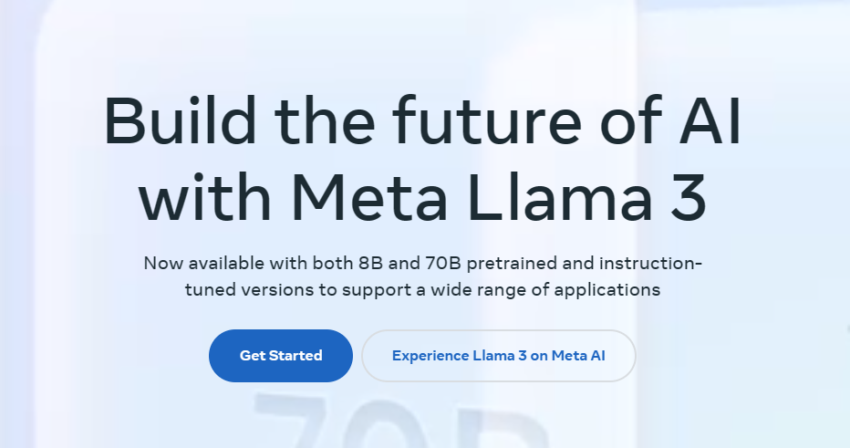
Last minute news
Llama 3 released on April 18th
8B Model almost as good as Llama 2 70B
70B Model better than Claude 3 Sonnet
400B Model currently under training!

Slide 13
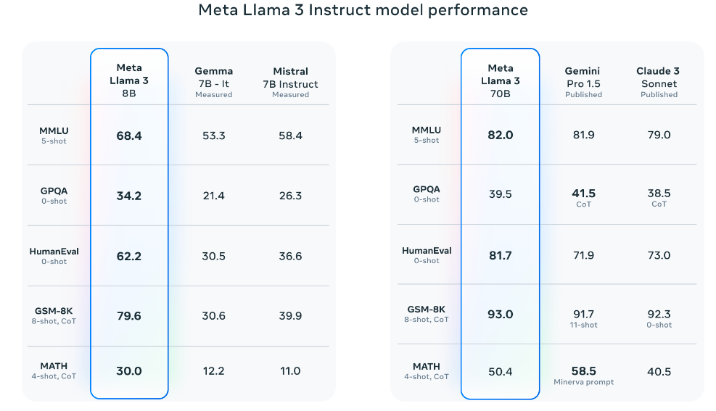
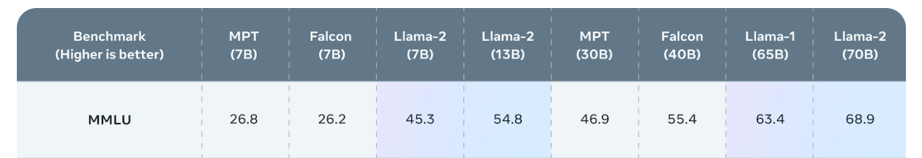
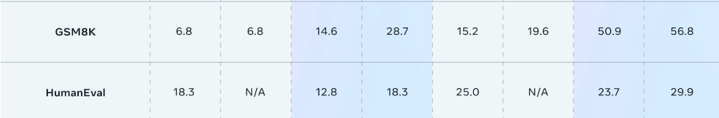
Llama 3 benchmark
MMLU = Multiple Choice on many subjects
Humaneval = Generate Python code
GSM8K = 8th grade level math questions
Notes:
Natalia sold clips to 48 of her friends in April, and then she sold half as many clips in May. How many clips did Natalia sell altogether in April and May?

Slide 14
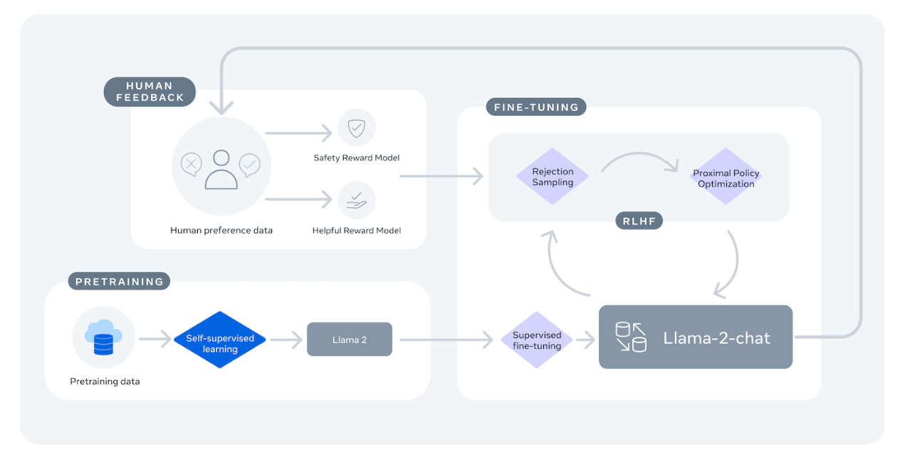
LLaMa 2 Training

Slide 15
Two always more distinct worlds
Difference between Optimization and Training

Slide 16
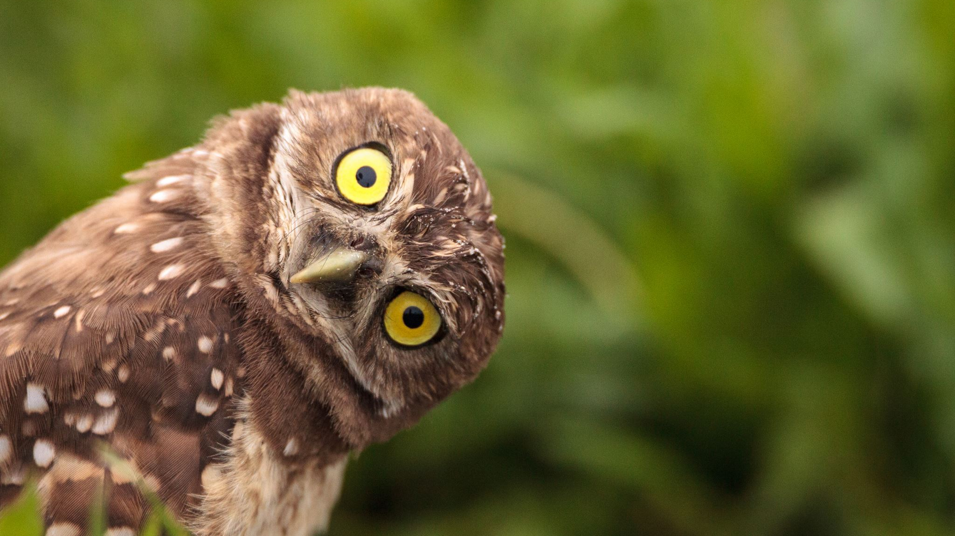
Questions?

Slide 17

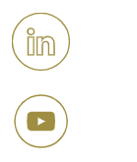

Seguici sui canali EuroCC Italy
Sito web www.euroccitaly.it
LinkedIN
YouTube
Co-funded by the European Union. This work has received funding from the European High Performance Computing Joint Undertaking (JU) and Germany, Bulgaria, Austria, Croatia, Cyprus, Czech Republic, Denmark, Estonia, Finland, Greece, Hungary, Ireland, Italy, Lithuania, Latvia, Poland, Portugal, Romania, Slovenia, Spain, Sweden, France, Netherlands, Belgium, Luxembourg, Slovakia, Norway, Türkiye, Republic of North Macedonia, Iceland, Montenegro, Serbia under grant agreement No 101101903.
<<<<<<<<<<
<

